Slide 1
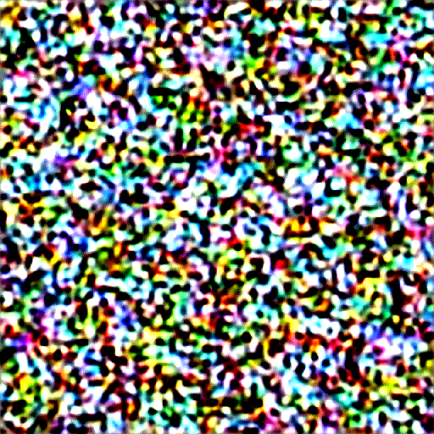
(Stable) Diffusion
Peeyush Singhal | Data Science Guild

Slide 2
Outline
Introduction and Overview of Diffusion
Toy Example
Stable Diffusion
Motivation
Inference
Training
Components – UNet, Guidance, etc.
Toy Example (IDE)
Difference with Diffusion
Toy Example (IDE)

Slide 3
Introduction and Overview of Diffusion
Motivation
Inference
Training
Components – UNet, Guidance

Slide 4
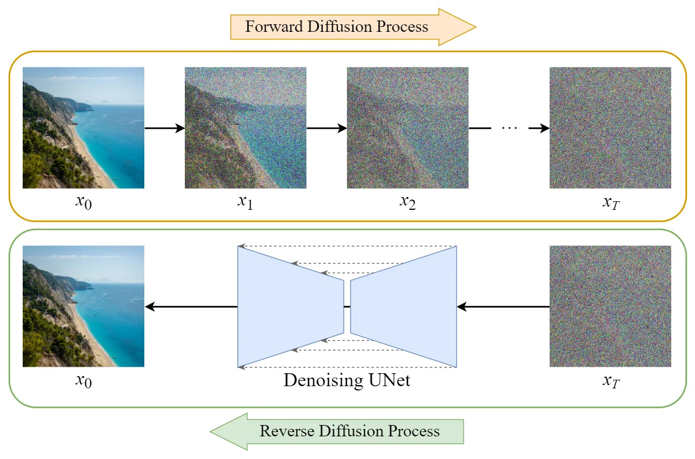
Motivation
Observation
Created from Noise (Magic!)
Created over time / in steps
Generative AI in Computer Vision
Questions
How the image is created from Noise?
Why this specific picture, why not something else?
….
Need
Creativeness
Speed
Business need
Fun
Training→
Applications
Midjourney
Sora
Microsoft Designer (needs personal account)
←Inference
Pictures: https://blog.marvik.ai/2023/11/28/an-introduction-to-diffusion-models-and-stable-diffusion/

Slide 5
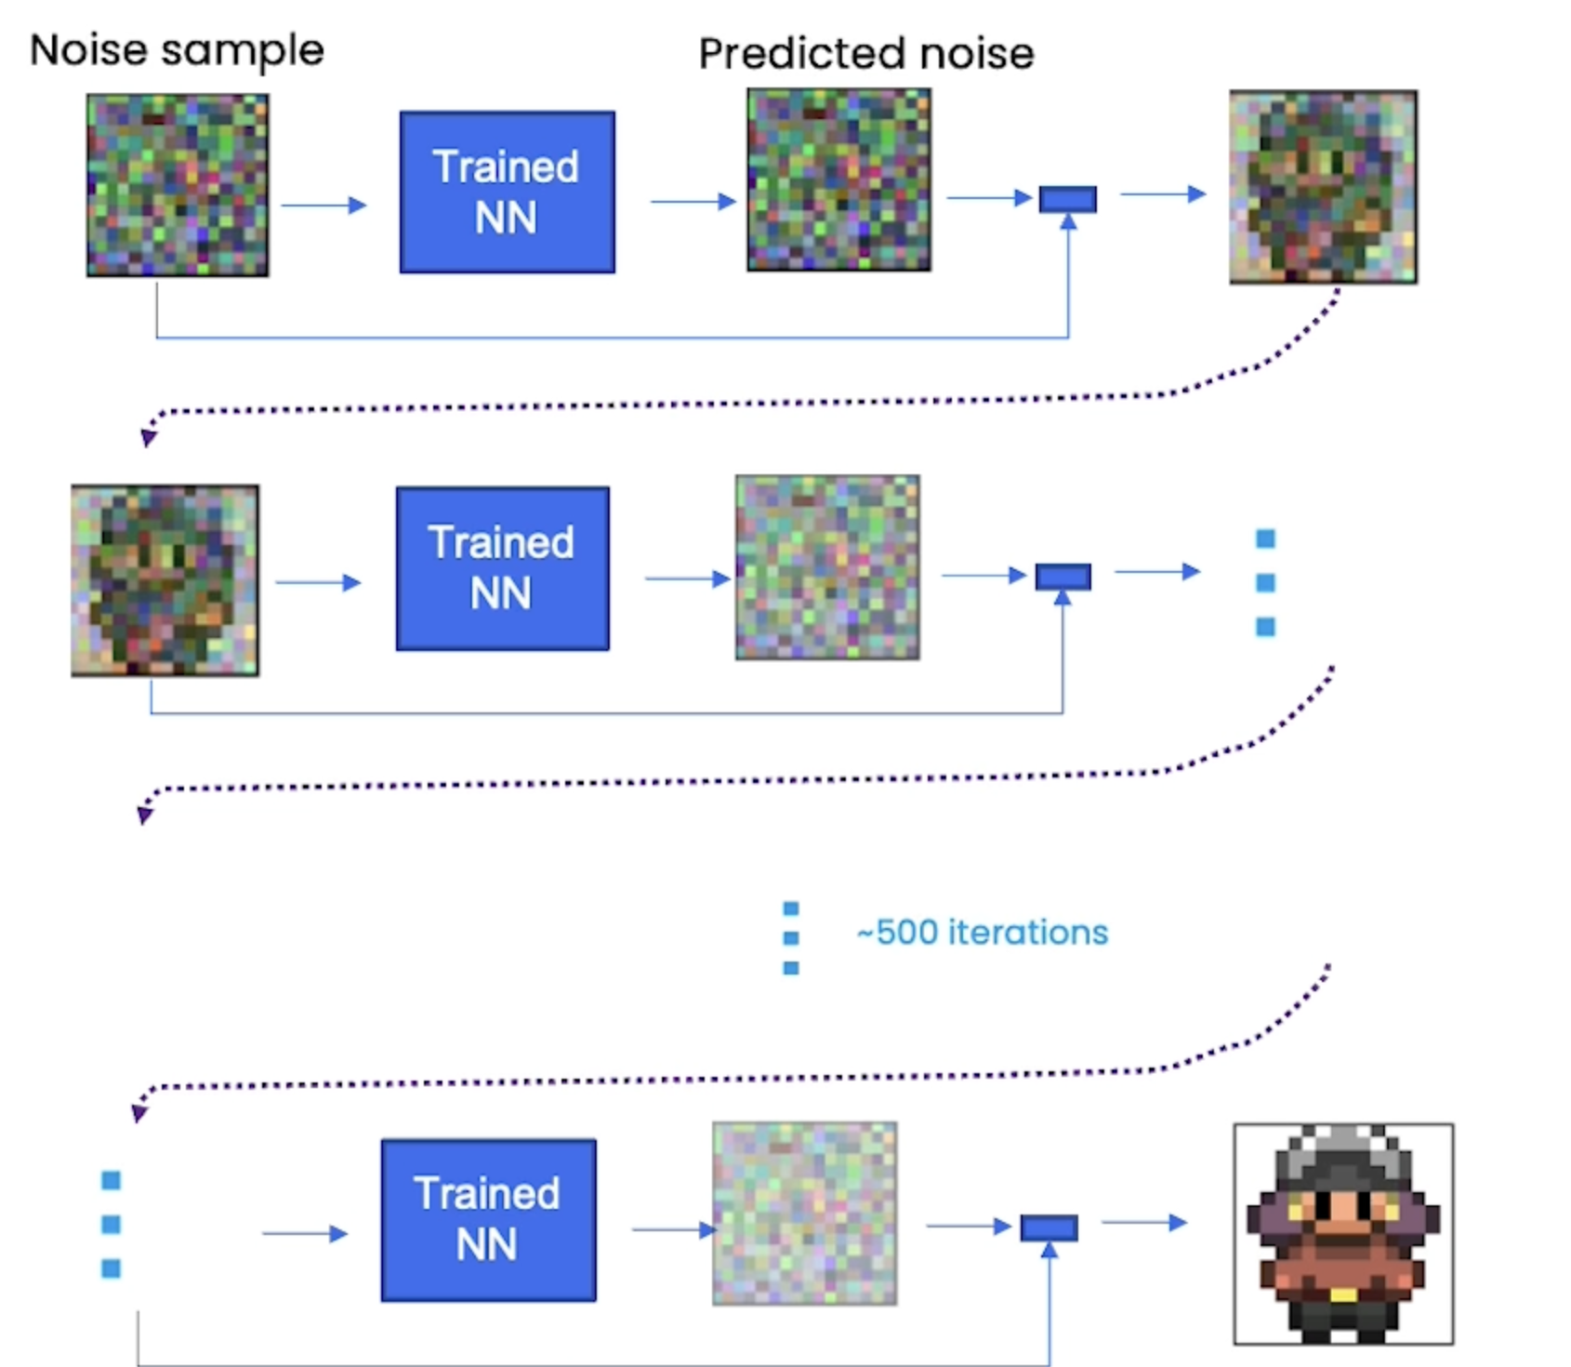


Inference (Using)
1
2
3
4
Image creation from Noise (Process)
1
Starts from Noise (pure, Gaussian)
2
Neural Network predicts Noise (What?)
3
Predicted Noise is subtracted from input
4
4
Cleaner output is generated
$$⋮$$
5
It takes many iterations (subject of research)
(Reverse Countdown, t=500 is noisy and t =1 is good image)
5
$$⋮$$
6
6
Final image is rendered
picture: Deeplarning.ai
Peeyush Singhal | Data Science Guild
Discussed in Toy Example

Slide 6
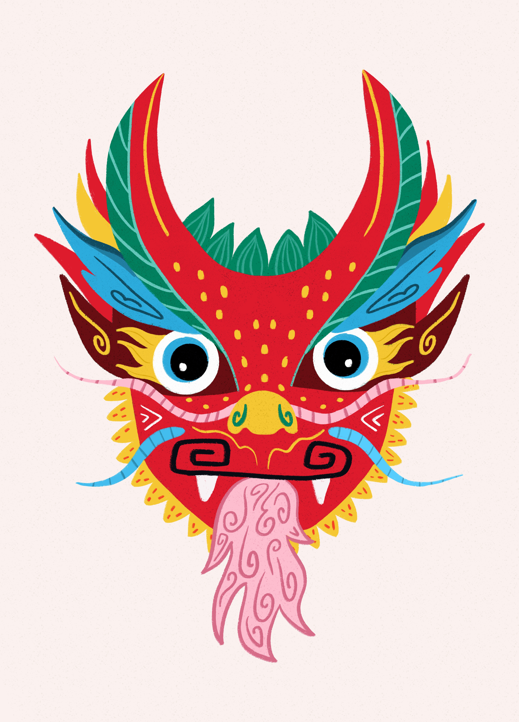
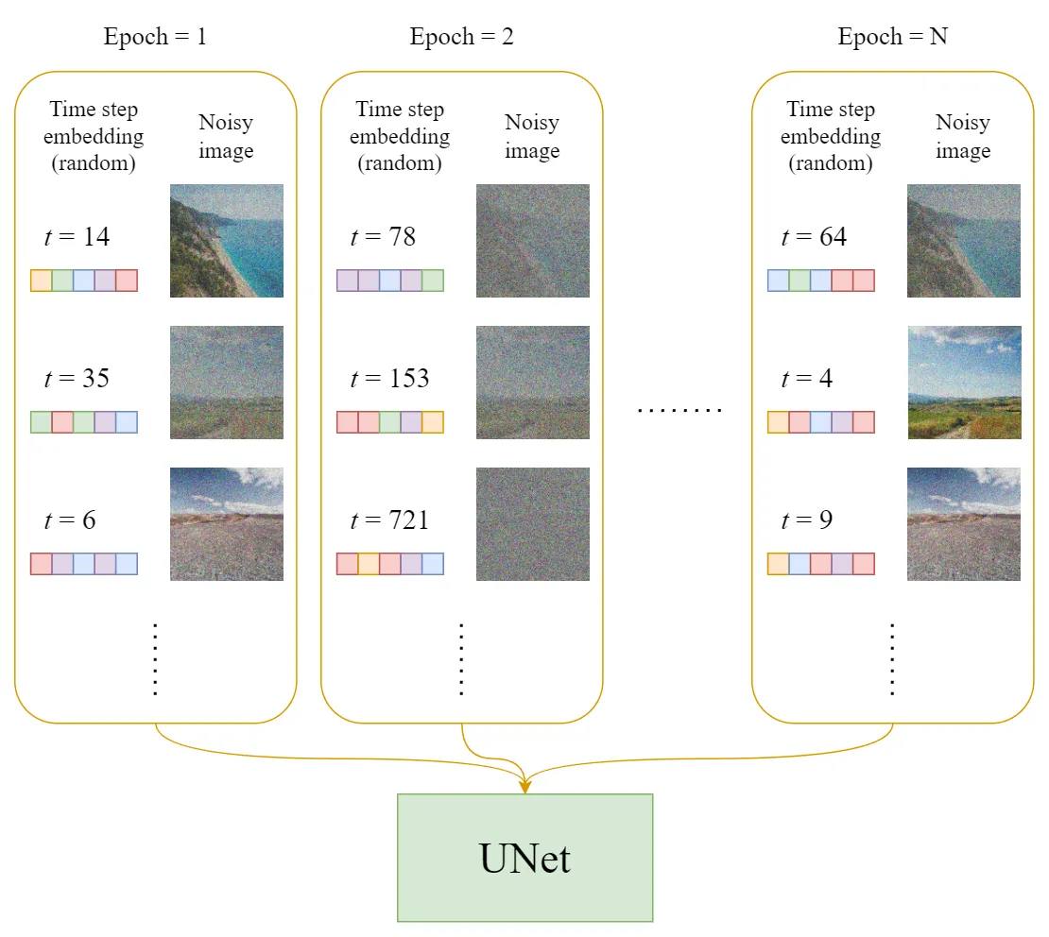
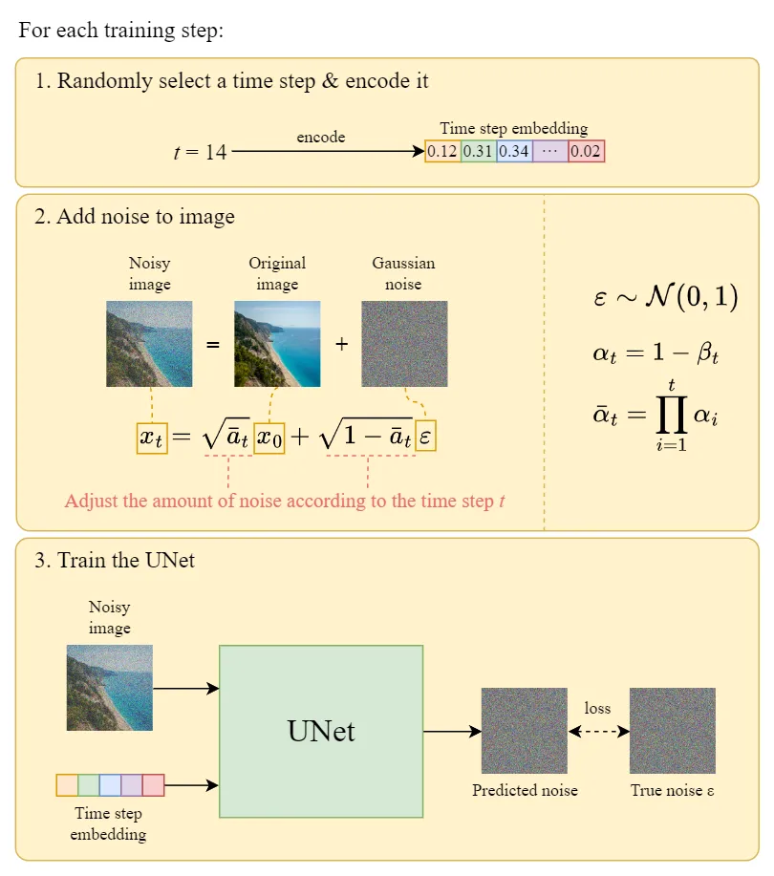
Training
How to train your ?
Pictures: https://blog.marvik.ai/2023/11/28/an-introduction-to-diffusion-models-and-stable-diffusion/
Discussed in Toy Example

Slide 7
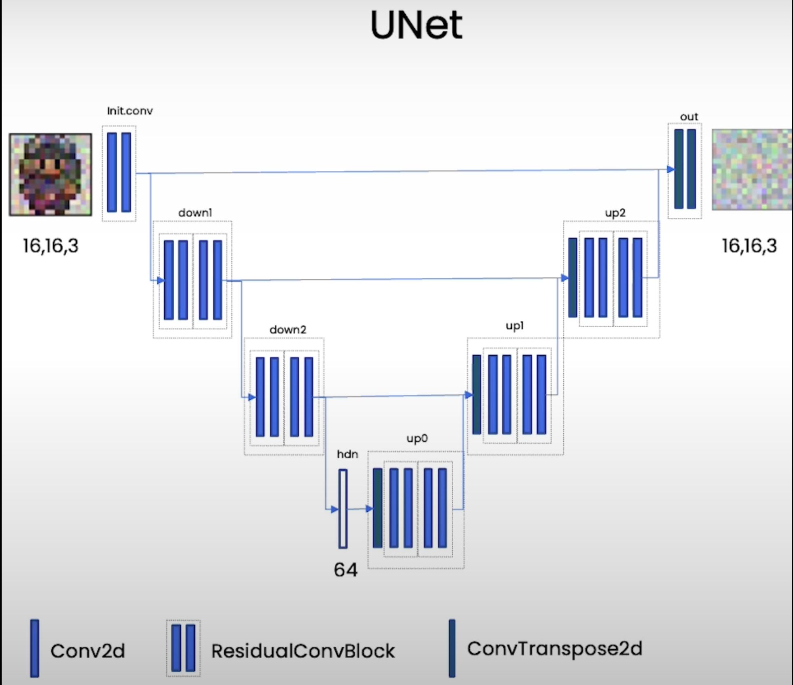
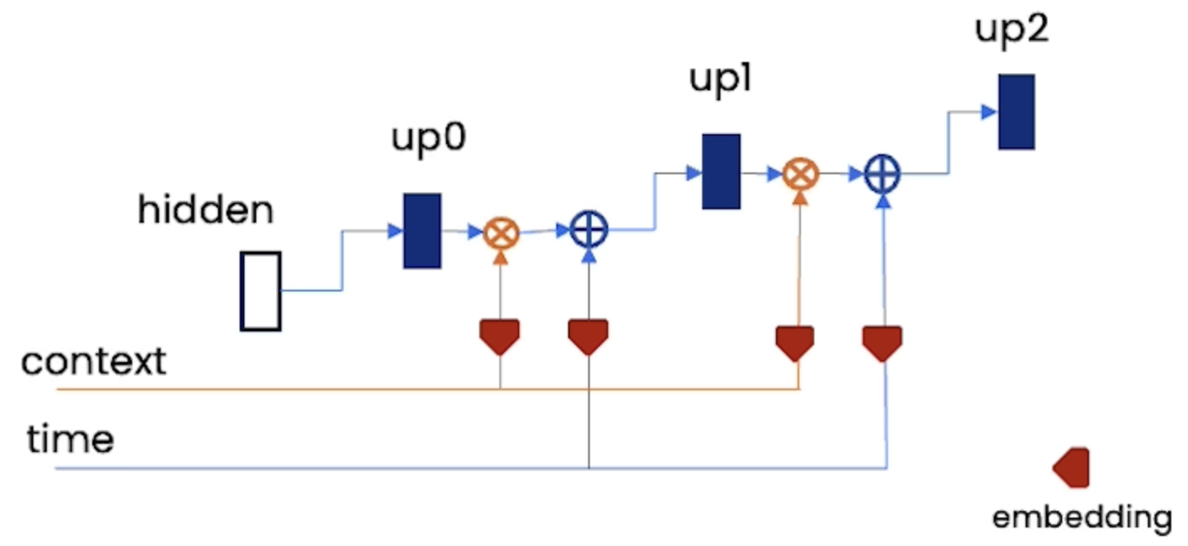
Components
Network (UNet) | Guidance (Conditioning/Context) | Time Embedding
Questions
How the image is created from Noise?
Why this specific picture, why not something else?
Answers
Use of time embedding (added)
Use of context (multiplied)
The workhorse of segmentation is used
Predicts Noise - Same size of Image
Loss function – L1 or MSE between pixels
pictures: Deeplarning.ai
Discussed in Toy Example

Slide 8
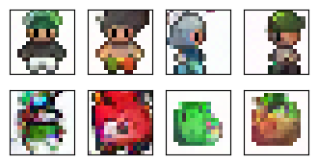
Toy (literally) Example
Creation of Sprite Creatures
<adapted from deeplearning.ai course : Diffusion Models>

Slide 9
Stable Diffusion

Slide 10
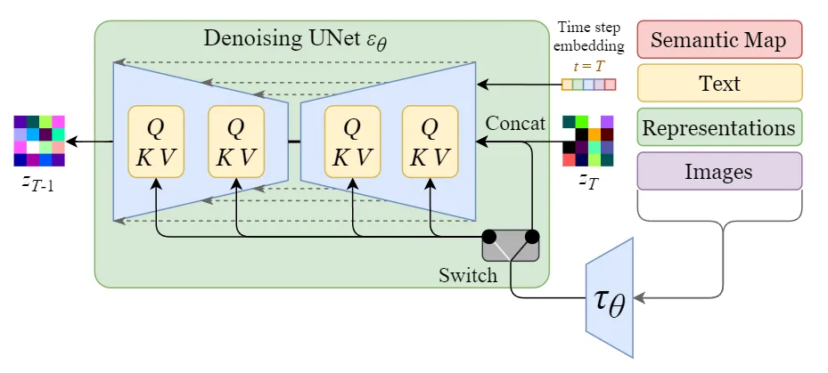
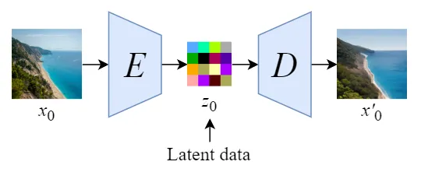
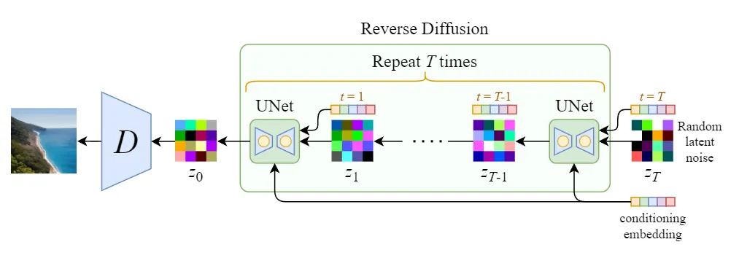
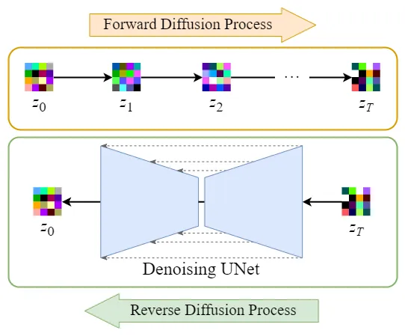
Stable Diffusion
Training→
What is stable in stable diffusion?
Stable diffusion is also called latent diffusion
←Inference
Training→
What has changed?
Working in latent space and not image space (dimensionality reduction, improves speed)
Use of pre-trained Autoencoders (E,D) to encode the image and decode the latent
←Inference
Pictures: https://blog.marvik.ai/2023/11/28/an-introduction-to-diffusion-models-and-stable-diffusion/

Slide 11
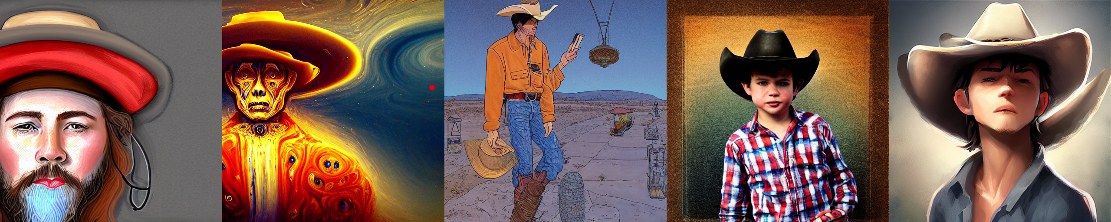
Toy Example
Use of Textual Inversion
Can we use this in Maps?

Slide 12
Thank You
Join #data-science-guild for
Exchange ideas
Discuss problems
Showcase outputs
Learn jointly

